Slide 1


MINISTRY OF EDUCATION AND TRAINING CAN THO UNIVERSITY COLLEGE OF INFORMATION AND COMMUNICATION TECHNOLOGY DEPARTMENT OF INFORMATION TECHNOLOGY
GRADUATION THESIS BACHELOR OF ENGINEERING IN INFORMATION TECHNOLOGY (HIGH-QUALITY PROGRAM) GRADE 10 ADMISSION MANAGEMENT SYSTEM FOR CAN THO CITY
Student: Kim Duy Thanh (B2105686)
Class: 2021-2025 (Cohort K47)
Advisor: Dr. Thai Minh Tuan

Slide 2
CONTENT
1. Introduction
2. Requirements analysis
3. System design
4. System implementation
5. Conclusion

Slide 3

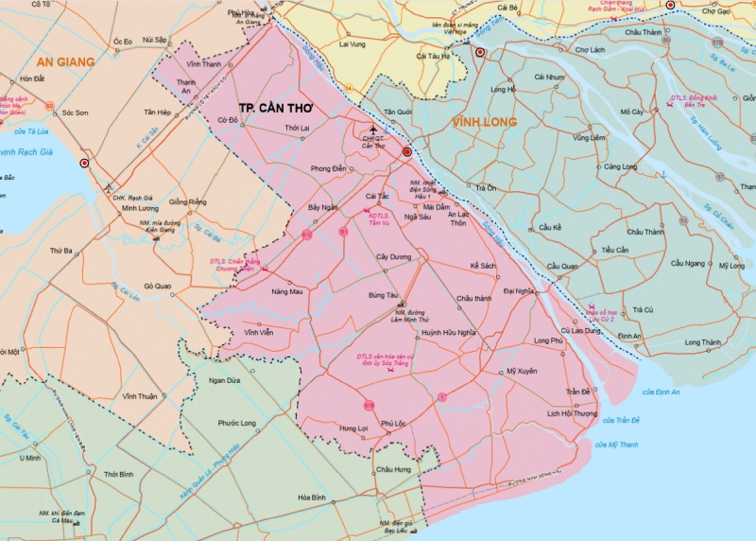
INTRODUCTION
Overview of research situation
- The current admission system of Can Tho City:
+ Provide initial benefits to users, but
+ Lack of local distinctiveness
+ UI - UX is not easy-to-use for users
- The merger of Can Tho, Soc Trang and Hau Giang from 1st July, 2025

Slide 4
INTRODUCTION
Reason for choosing the topic
- Synchronize admission data and process of old provinces, cities
- Improving, developing the system with a typical image of the new Can Tho city
Purposes of the thesis
- Design an application to support high school admissions for grade 10 students in Can Tho city on cross-platform (web, mobile)
- Improve the experience and efficiency of teachers, parents, students and other user groups

Slide 5
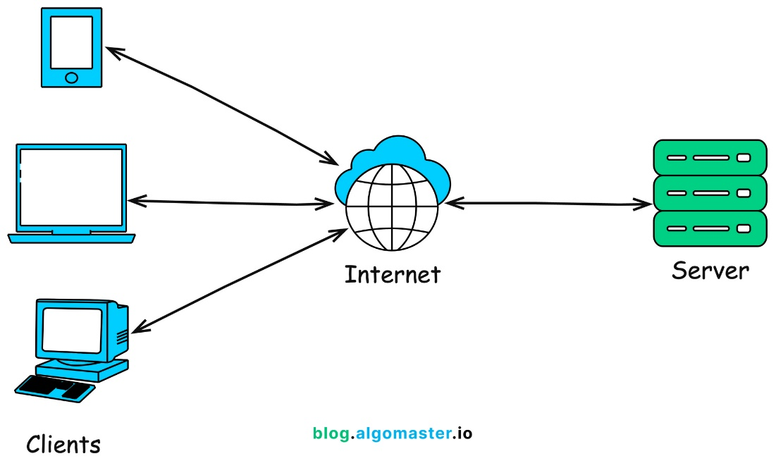
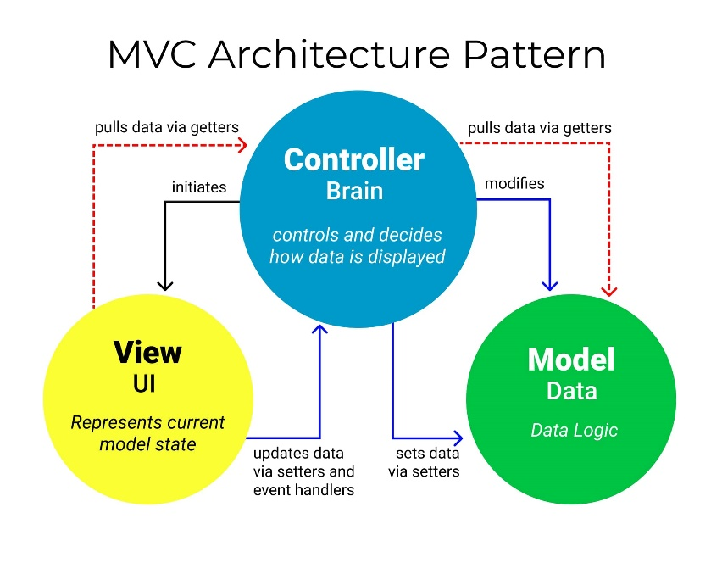
INTRODUCTION
Background
- Client - Server model
- Model - View - Controller (MVC)
Client - Server

Slide 6







INTRODUCTION
Tech stack
Backend:
Database: Server:
Frontend:
Web application: Mobile application:
Other APIs:

Slide 7
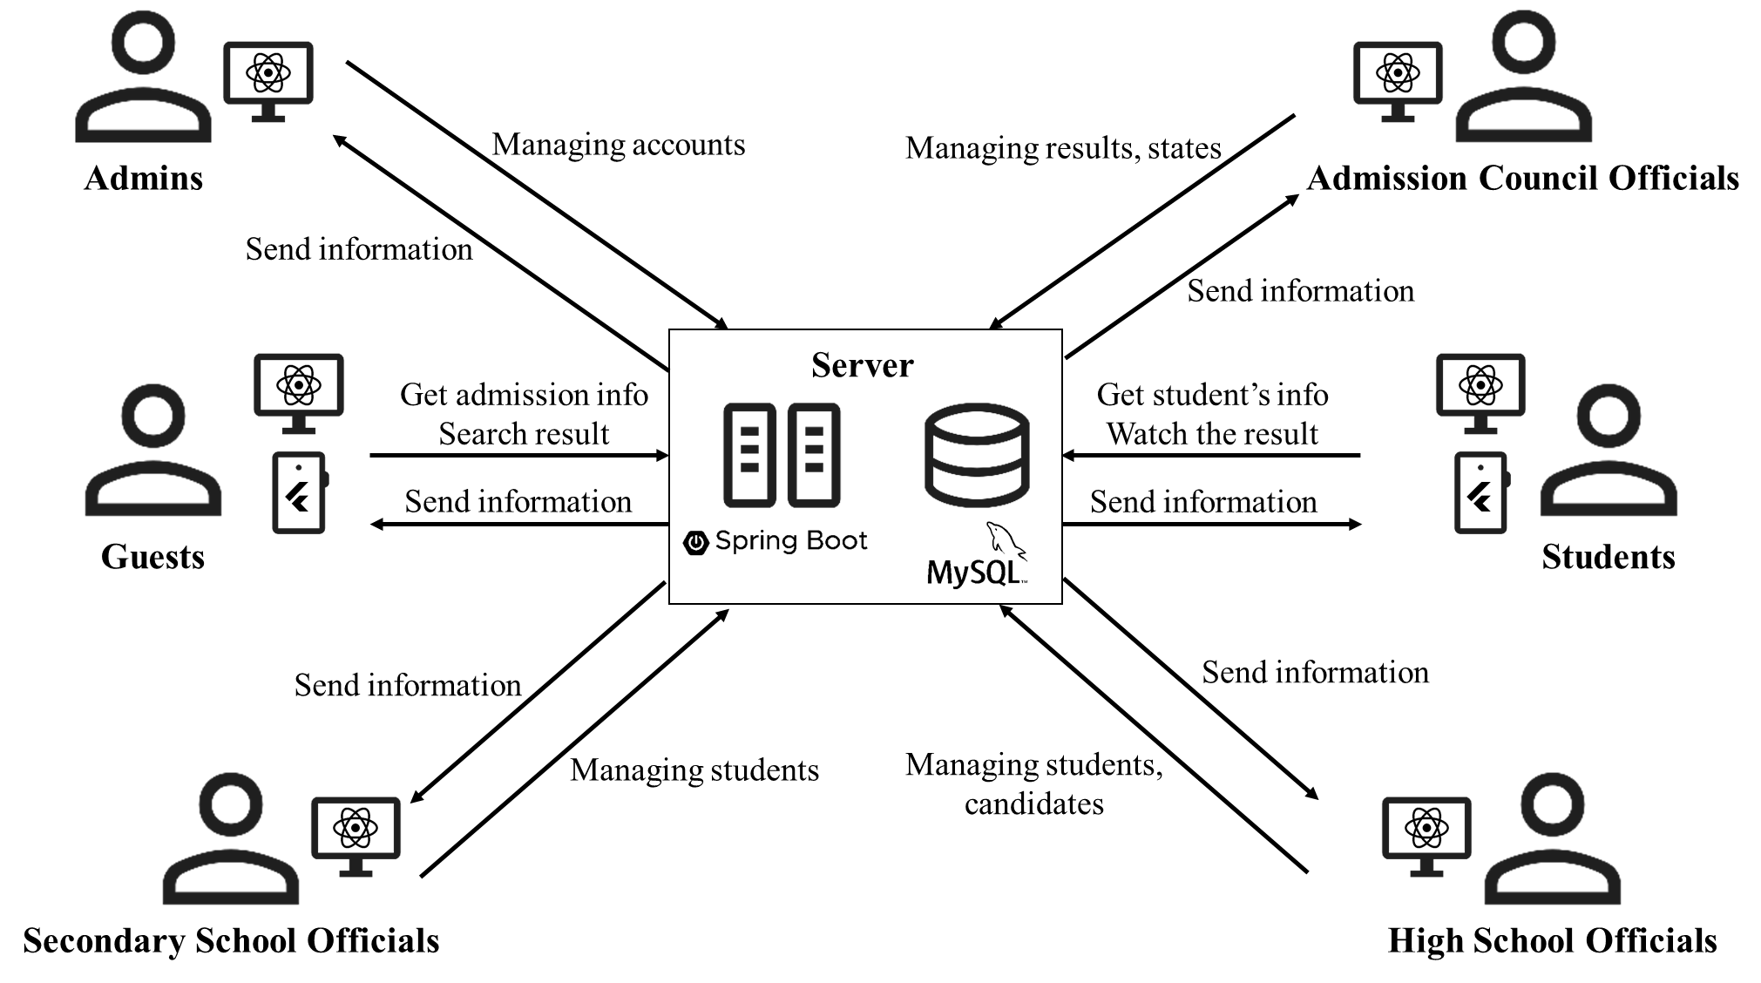
REQUIREMENTS ANALYSIS
The overview flow of the system:
54 use cases
6 user groups

Slide 8
REQUIREMENTS ANALYSIS
Use Case Diagram for Guest users:

Slide 9
REQUIREMENTS ANALYSIS
Use Case Diagram for general functions of logged-in users:

Slide 10
REQUIREMENTS ANALYSIS
Use Case Diagram for Administrators:

Slide 11
REQUIREMENTS ANALYSIS
Use Case Diagram for Admissions Council Officials:

Slide 12
REQUIREMENTS ANALYSIS
Use Case Diagram for Secondary School Officials:

Slide 13
REQUIREMENTS ANALYSIS
Use Case Diagram for High School Officials:

Slide 14
REQUIREMENTS ANALYSIS
Use Case Diagram for Students:

Slide 15
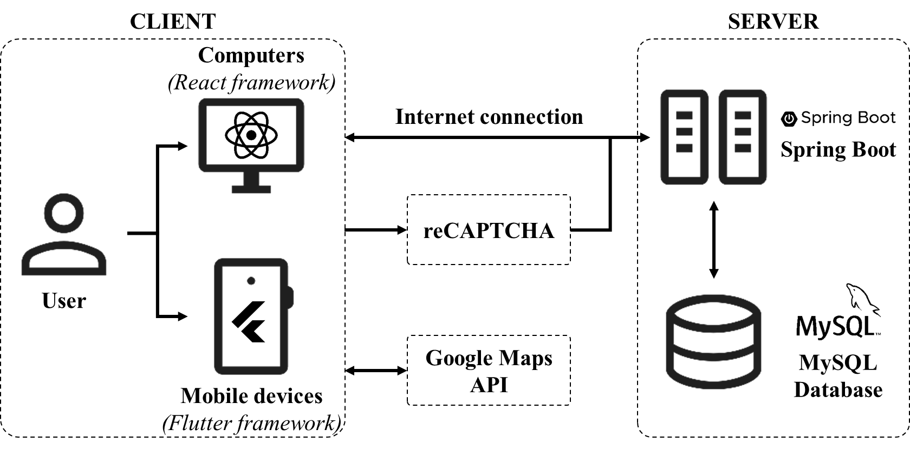
SYSTEM DESIGN
Architecture model:

Slide 16
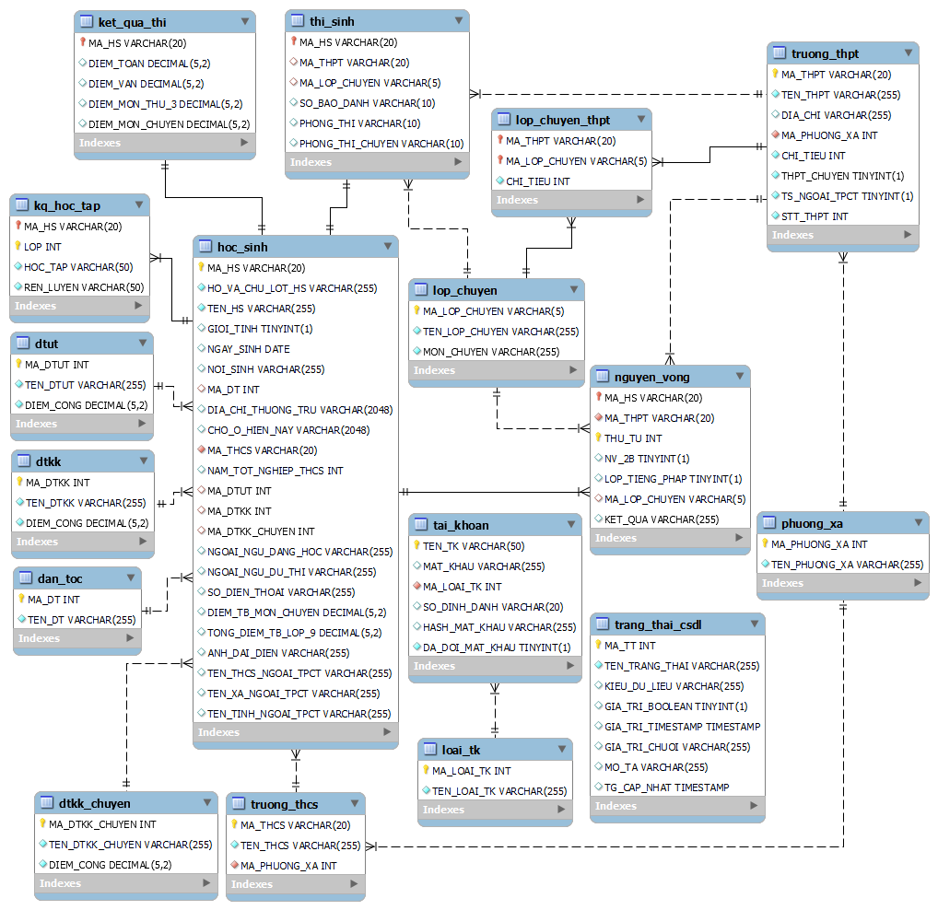
SYSTEM DESIGN
Entity Relationship Diagram:
Simplified version
Detailed version

Slide 17
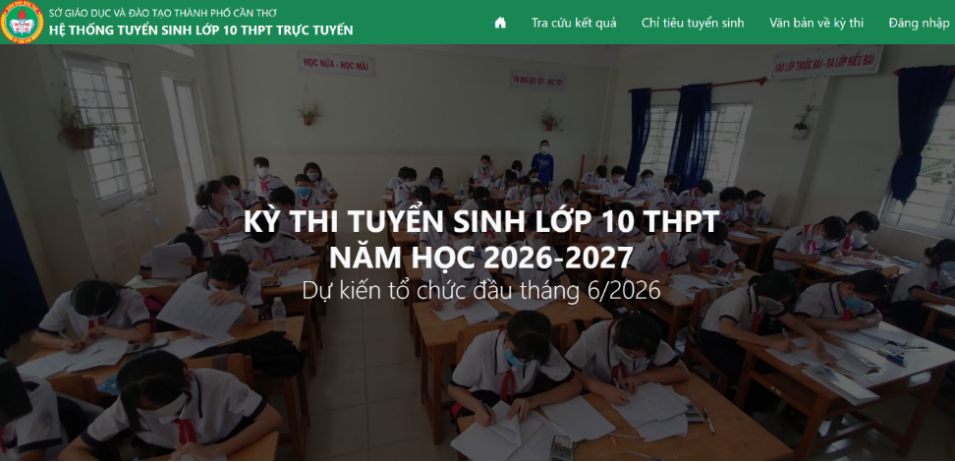
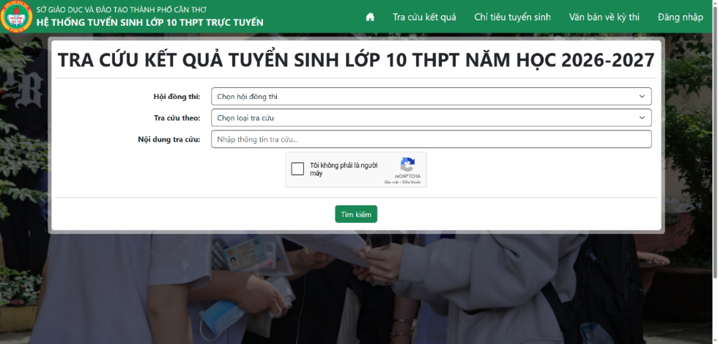
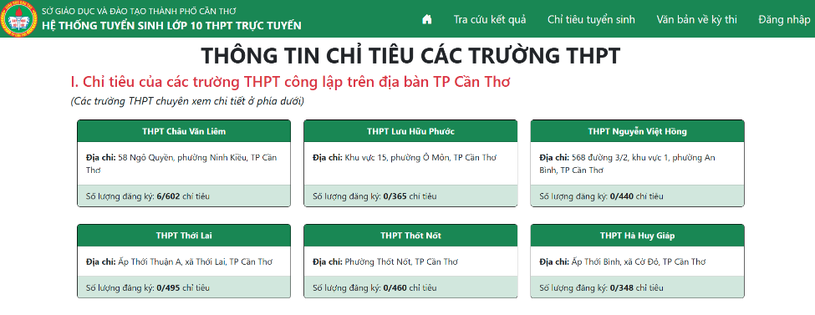
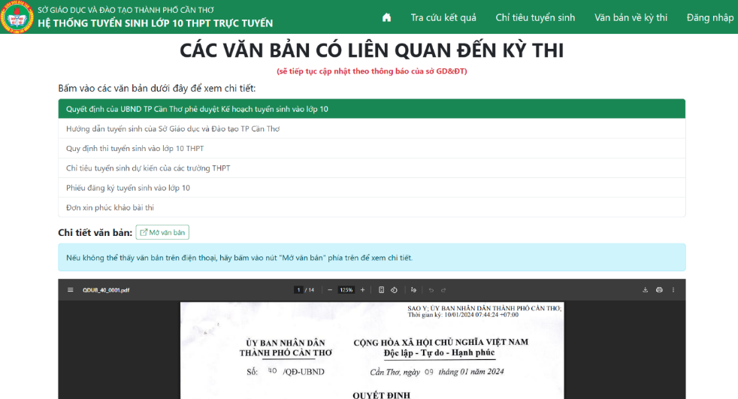
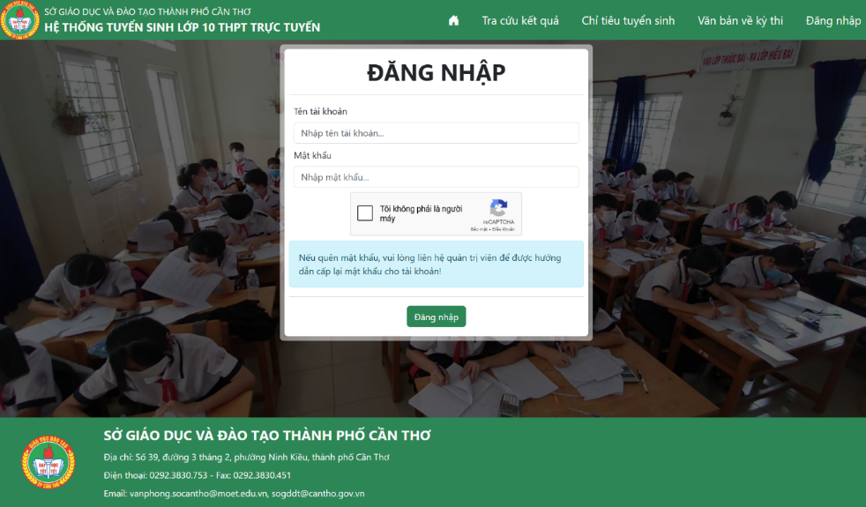
SYSTEM IMPLEMENTATION
Web application (Guest users):

Slide 18
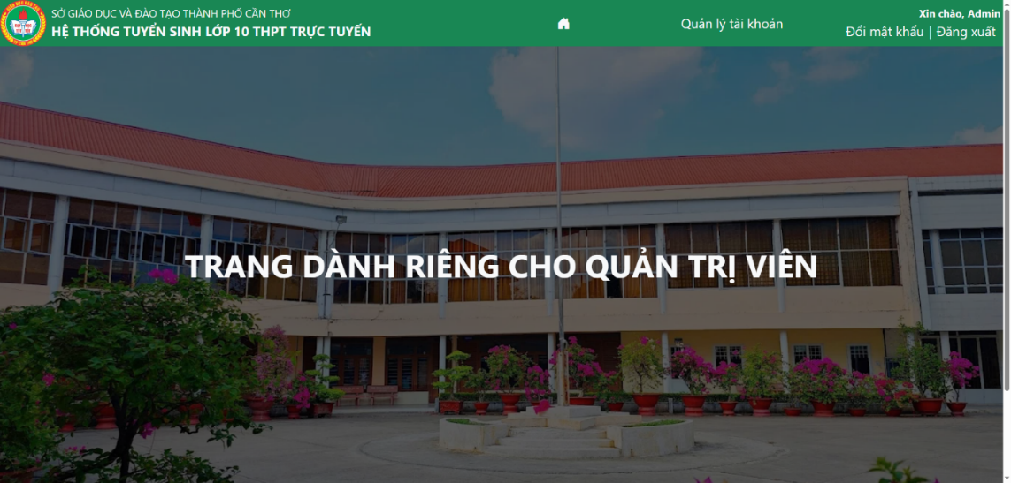
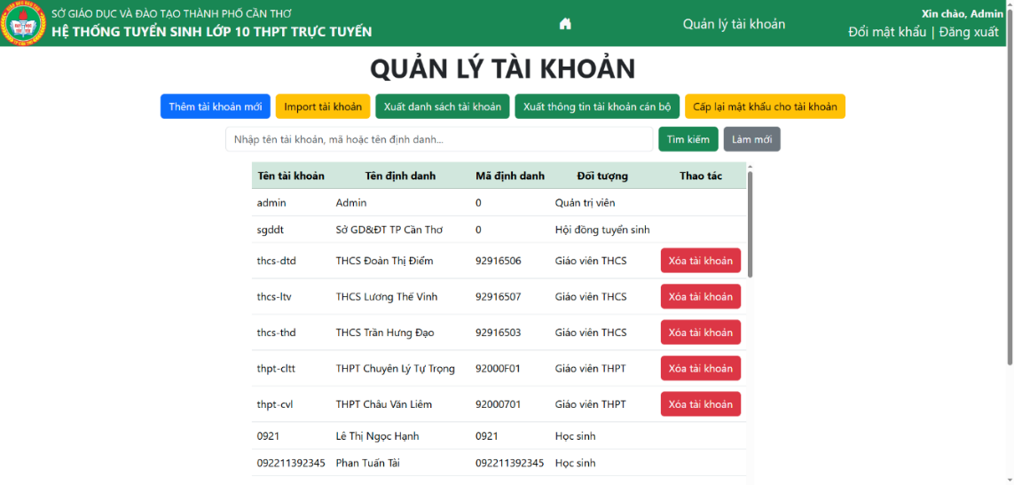
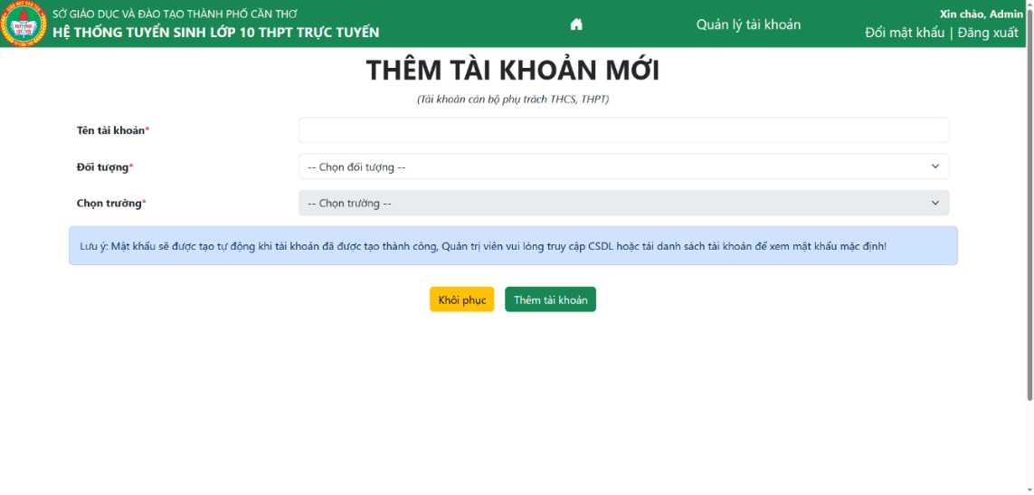
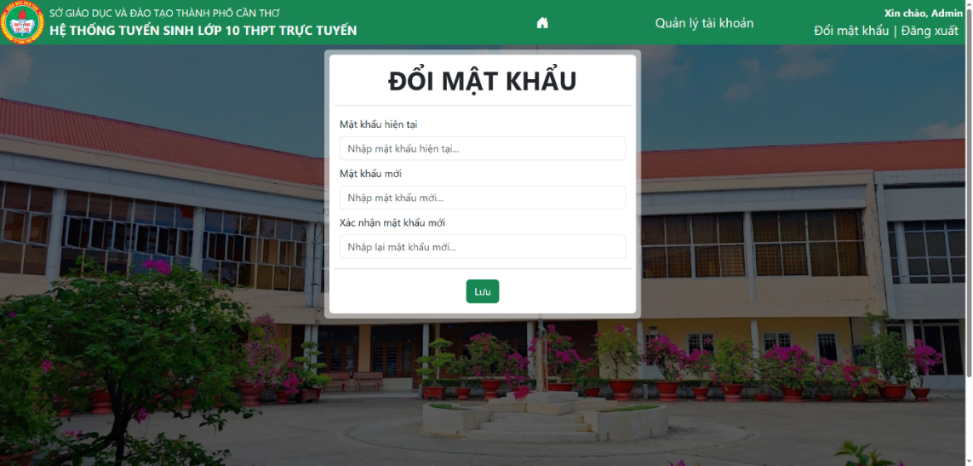
SYSTEM IMPLEMENTATION
Web application (Administrators):

Slide 19
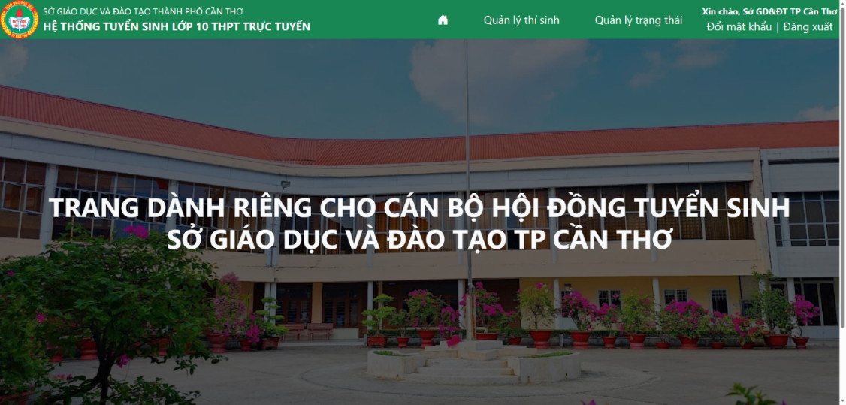
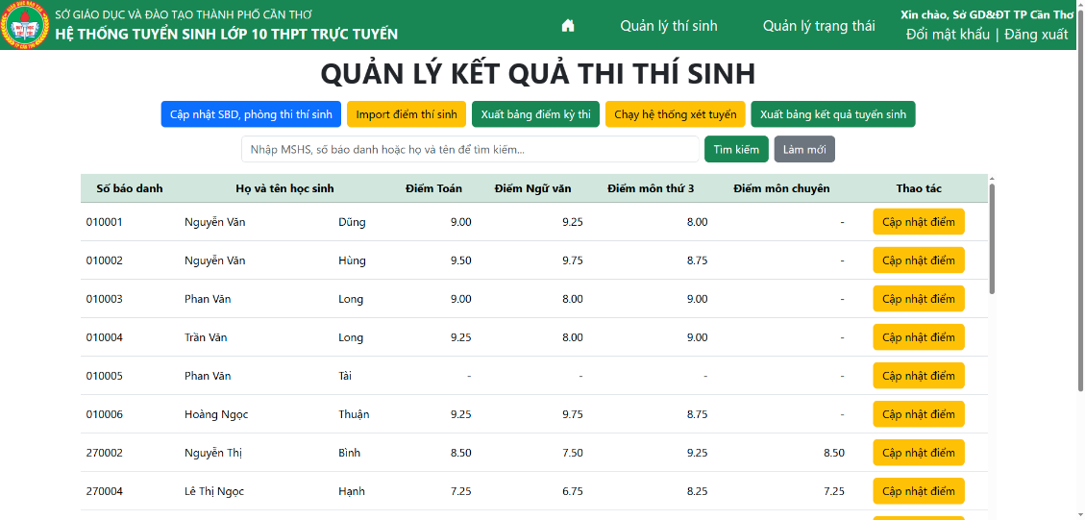
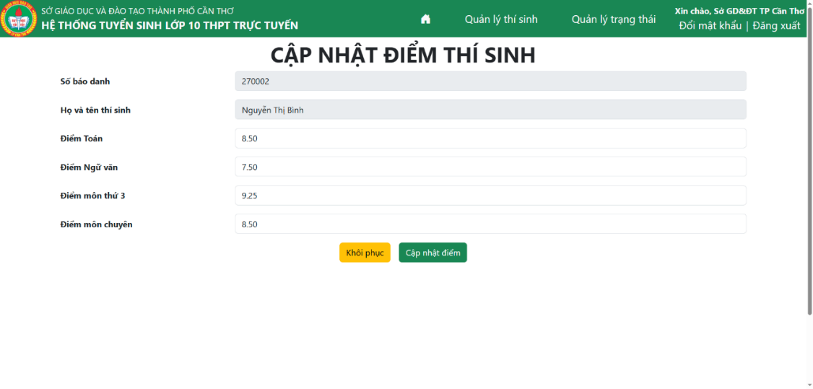
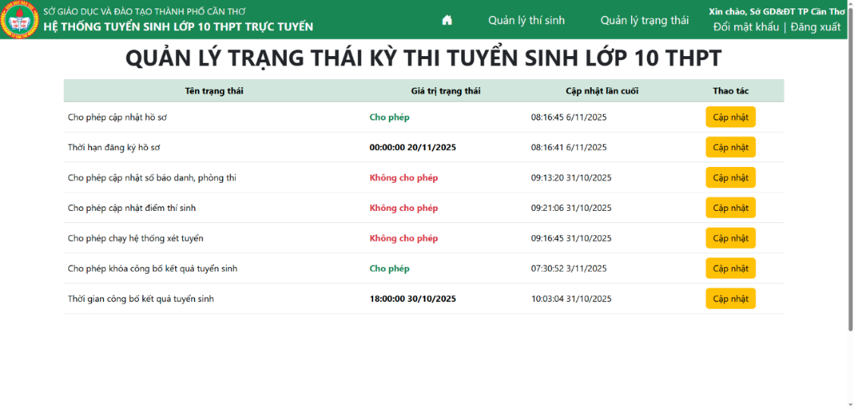
SYSTEM IMPLEMENTATION
Web application (Admissions Council Officials):

Slide 20

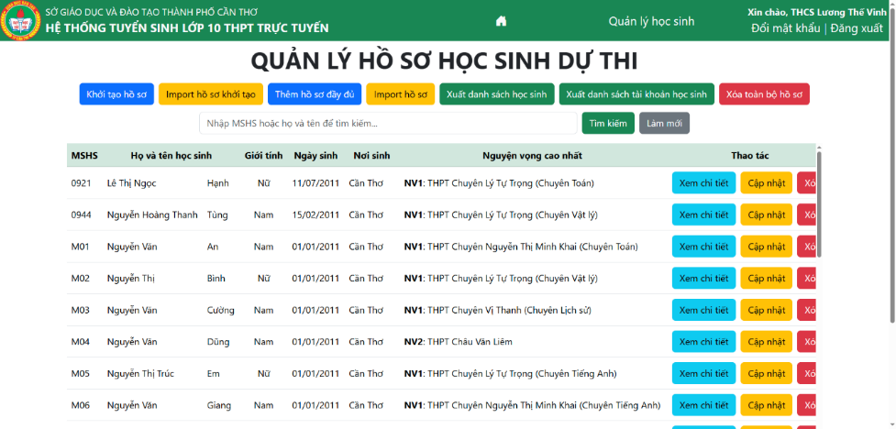
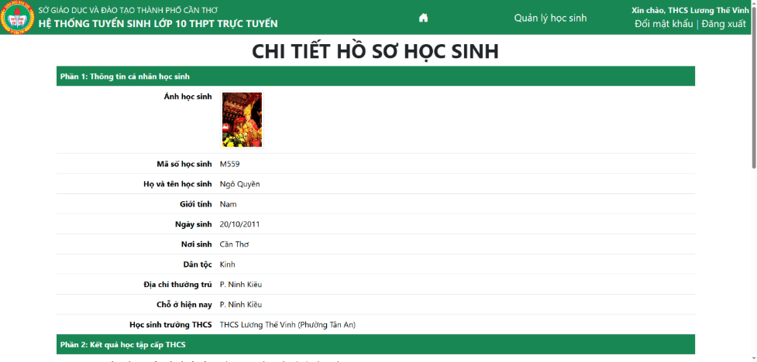
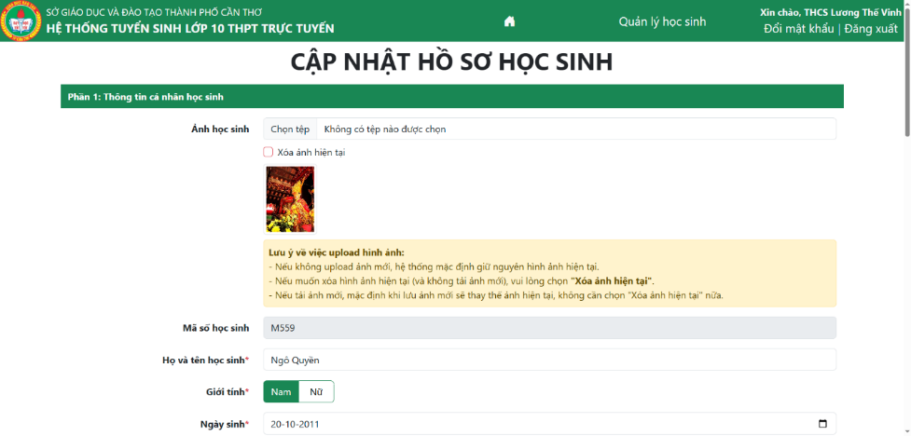
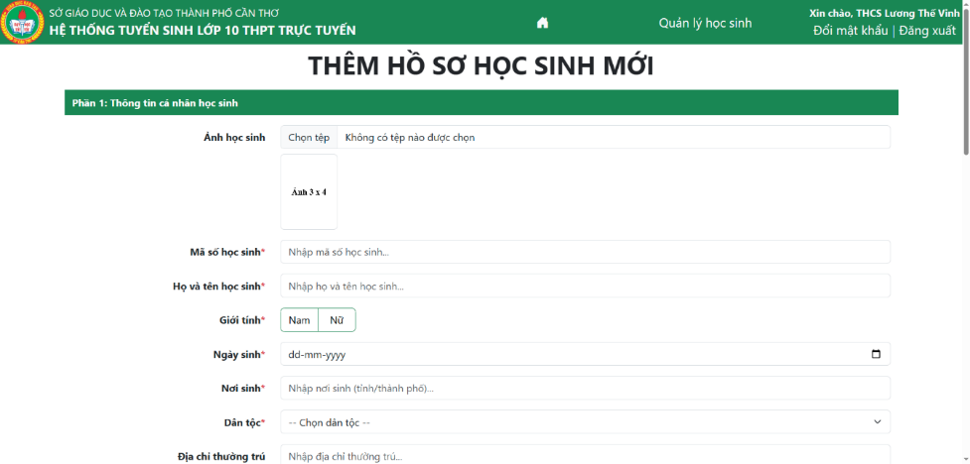
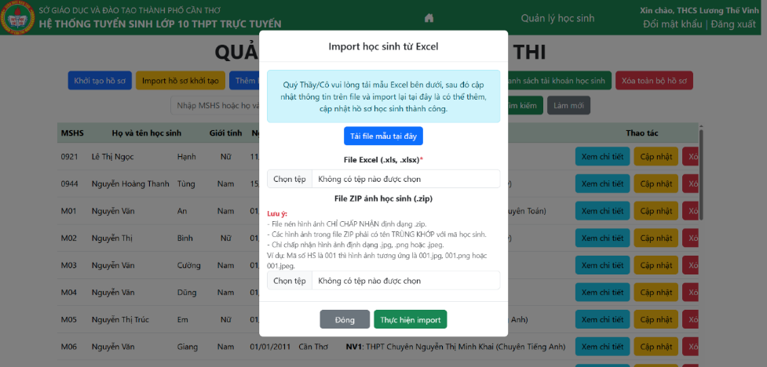
SYSTEM IMPLEMENTATION
Web application (Secondary School Officials):

Slide 21

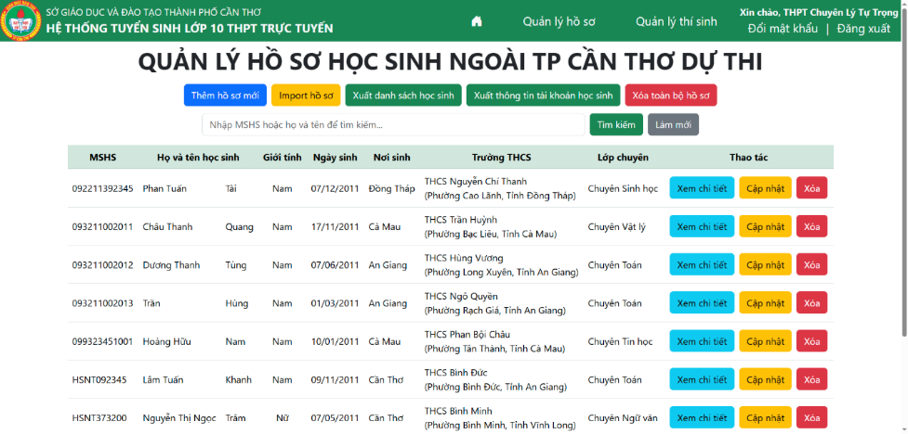
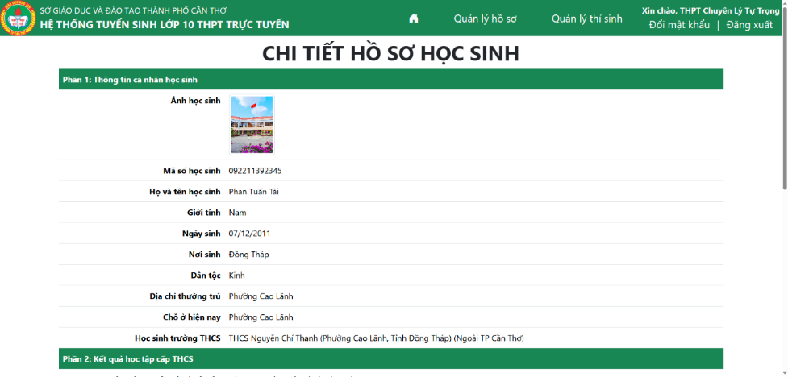
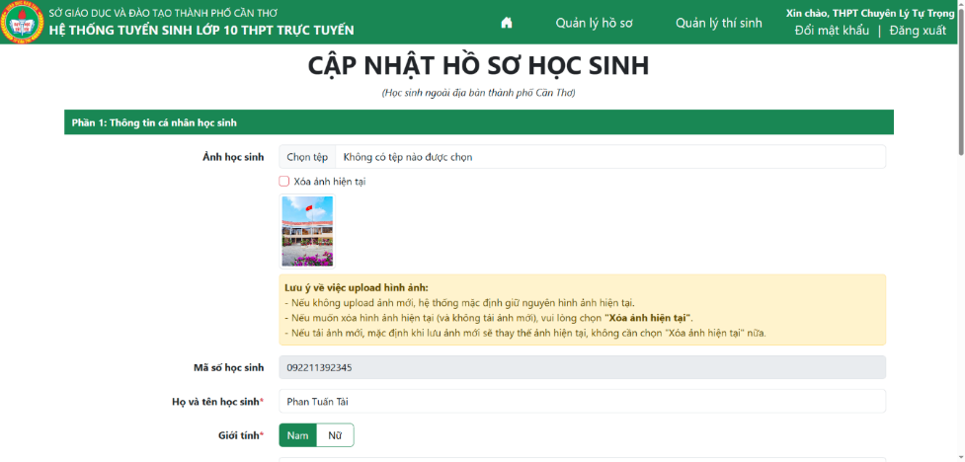
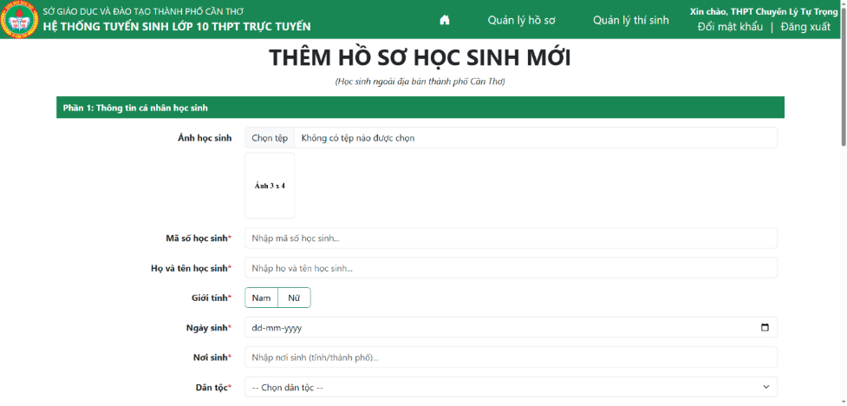
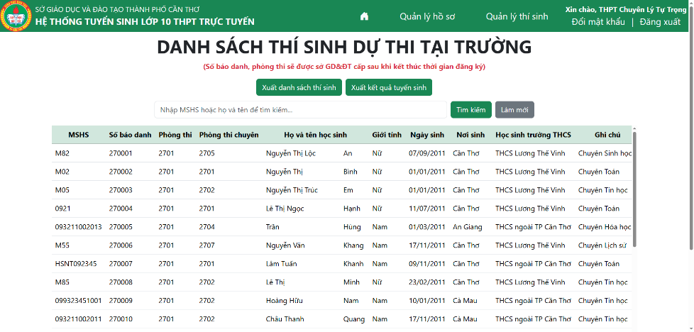
SYSTEM IMPLEMENTATION
Web application (High School Officials):

Slide 22
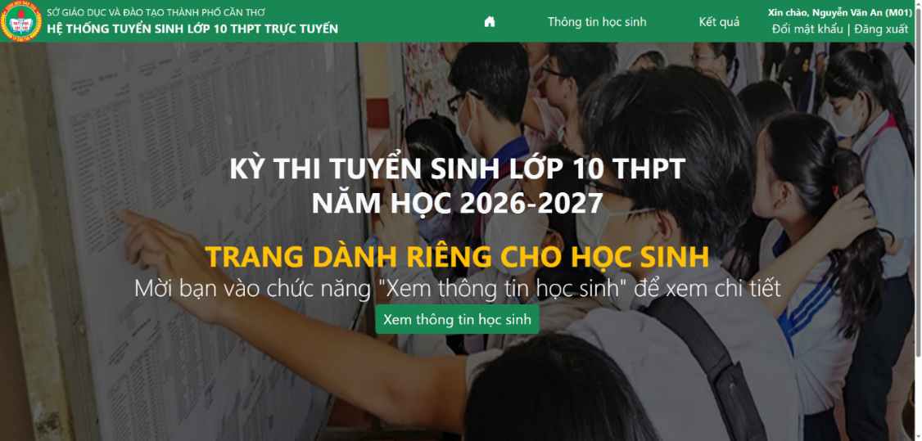
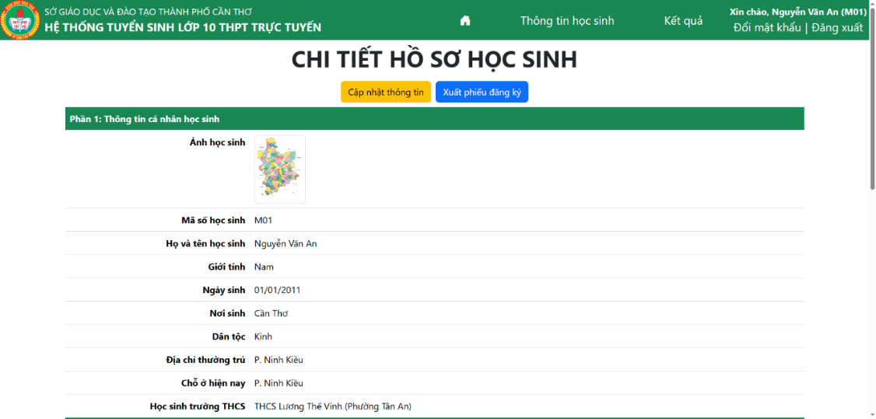
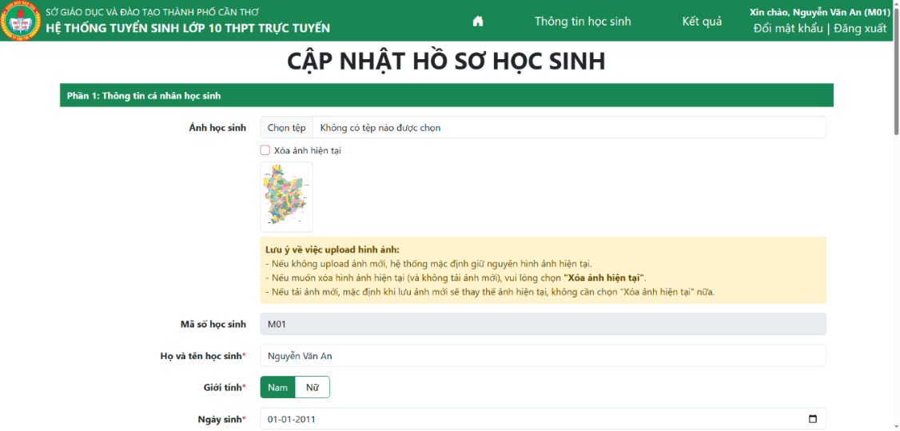
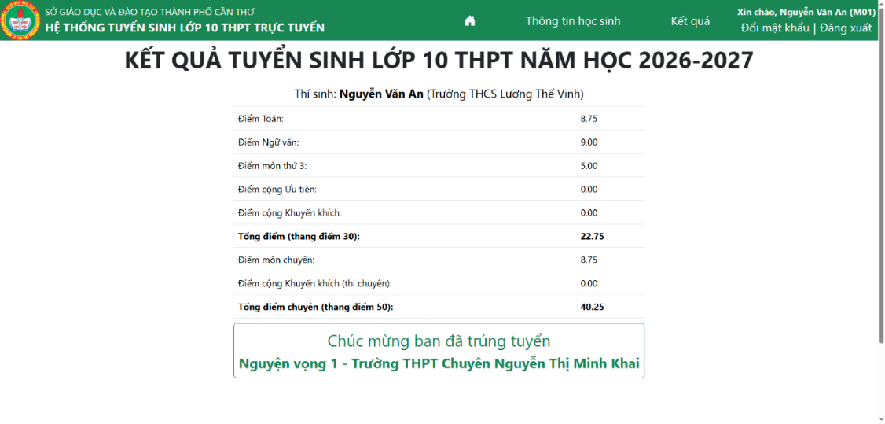
SYSTEM IMPLEMENTATION
Web application (Students):

Slide 23
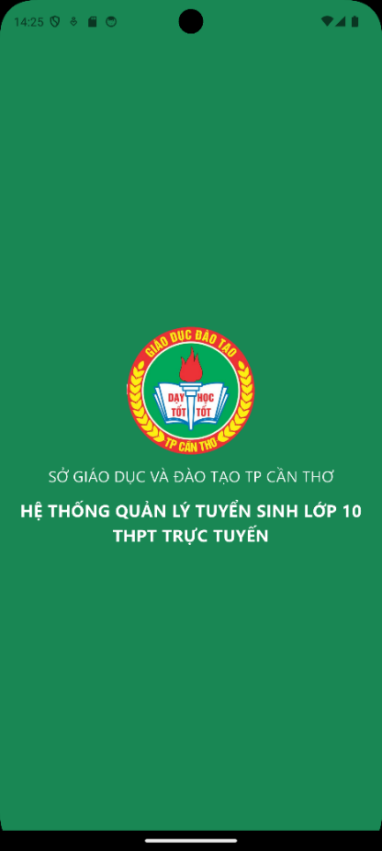
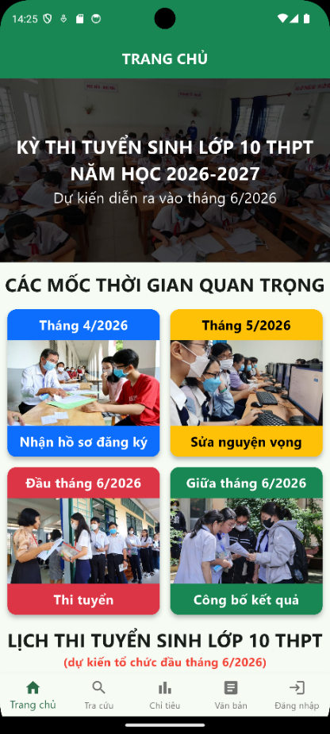
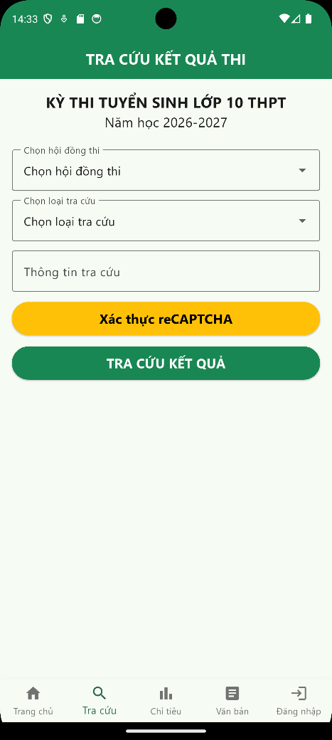
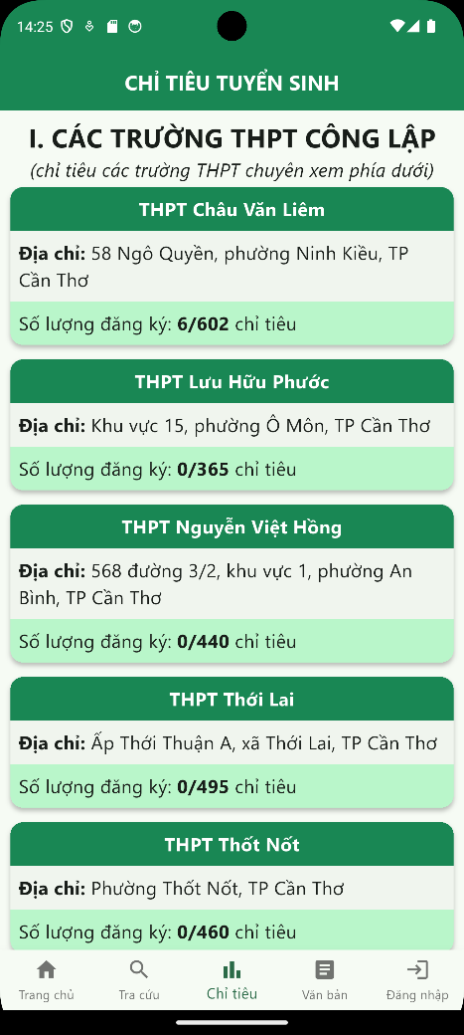
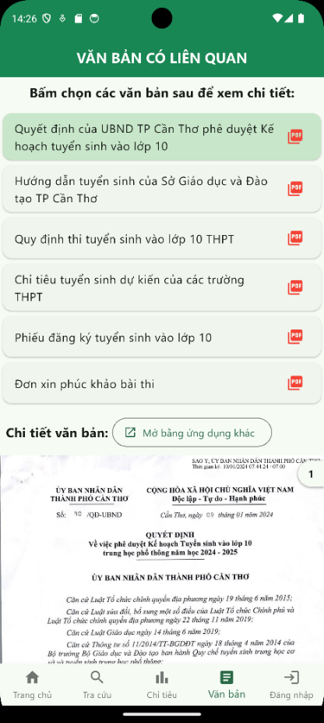
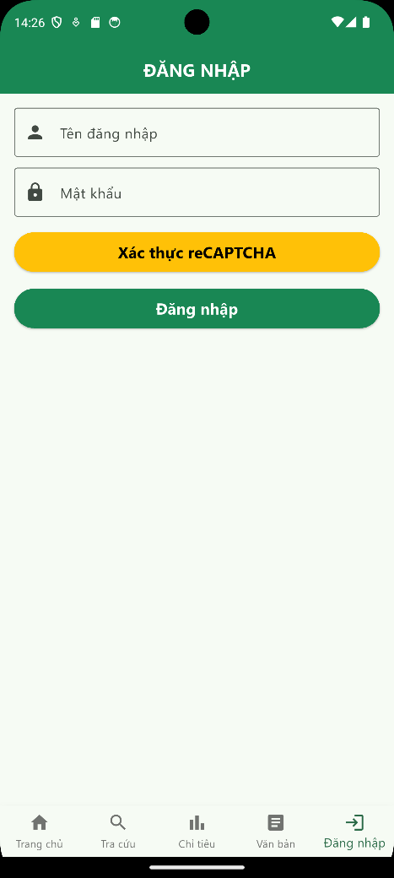
SYSTEM IMPLEMENTATION
Mobile application (Guest users):

Slide 24
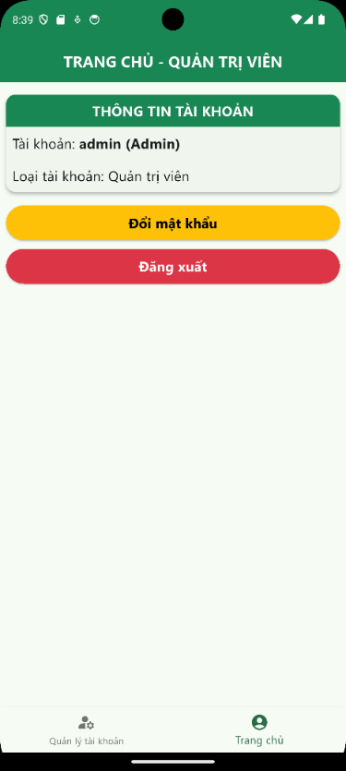
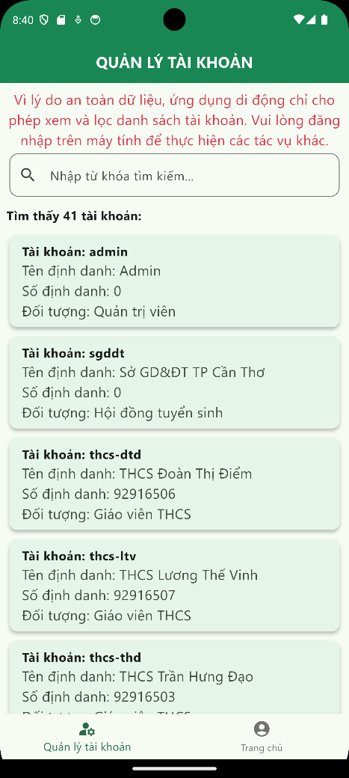
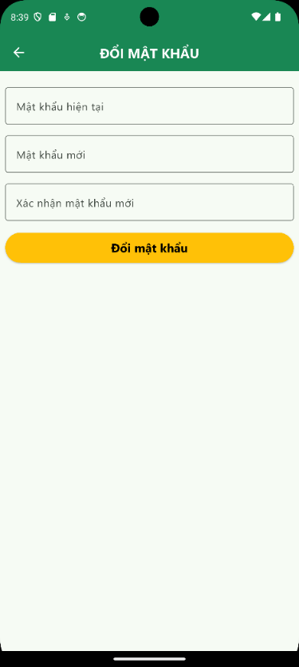
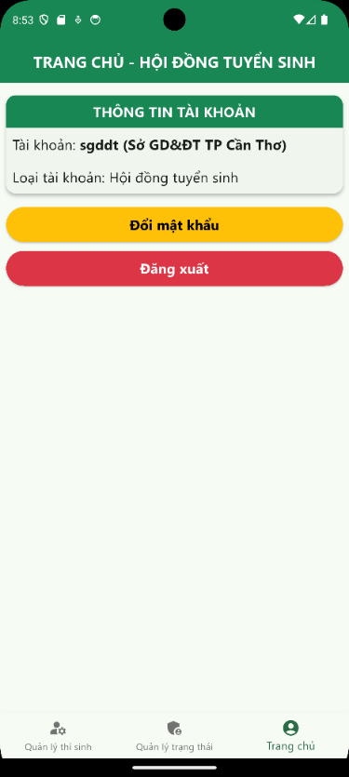
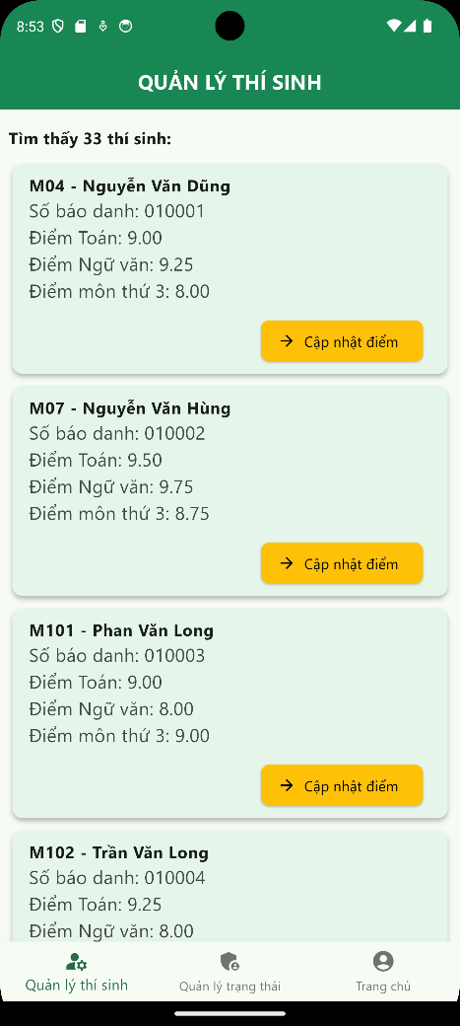
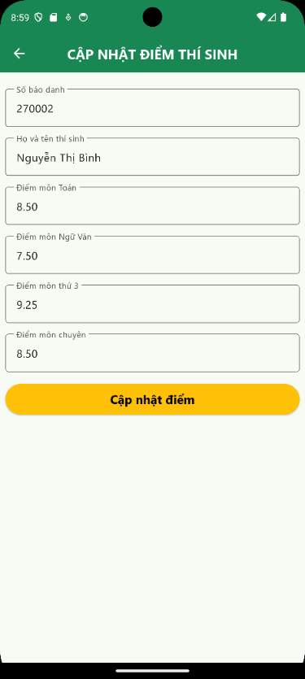
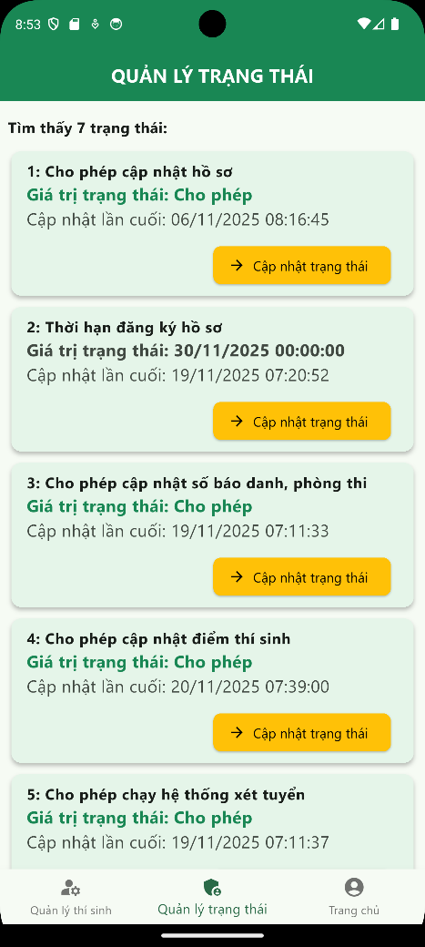
SYSTEM IMPLEMENTATION
Mobile application (Admins, Admissions Council Officials):

Slide 25
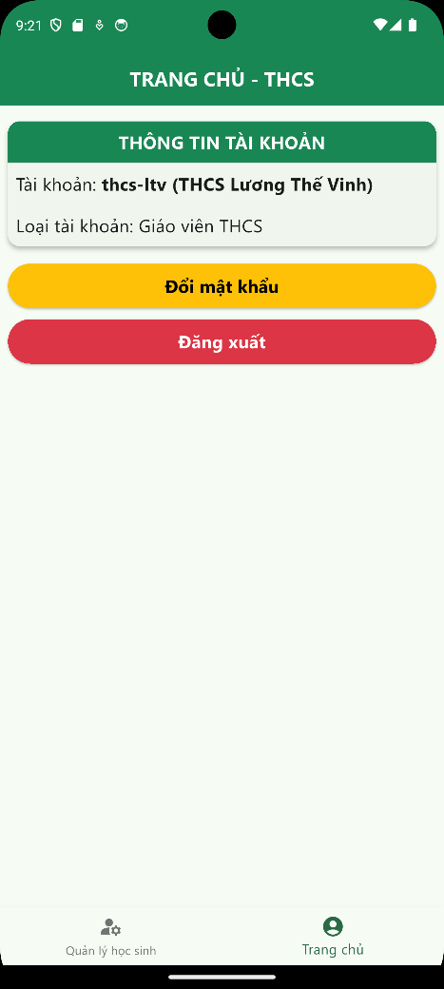
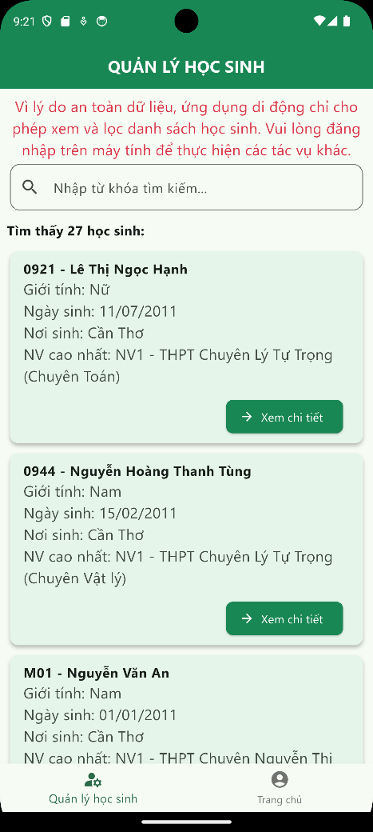
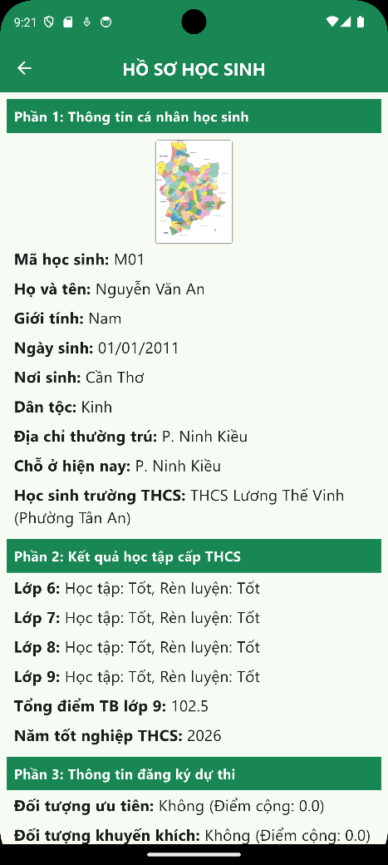
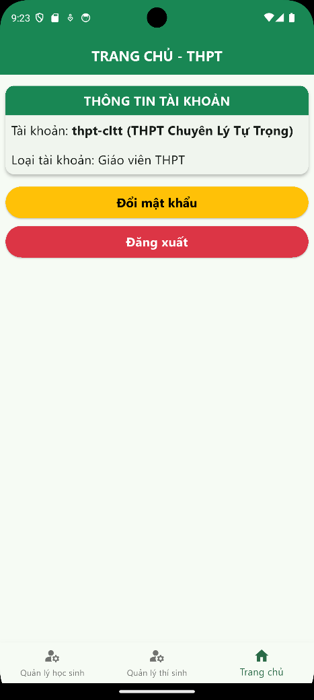



SYSTEM IMPLEMENTATION
Mobile application (Secondary School, High School Officials):

Slide 26


SYSTEM IMPLEMENTATION
Mobile application (Students):

Slide 27
CONCLUSION
Conclusion:
- All functions have been tested carefully and have been advised, evaluated, and commented on by officials in secondary schools, high schools in Can Tho city
- This application can replace the old admission systems of three cities, provinces to become the common system for the new Can Tho City
Future work:
- Exporting more documents relating to the admission exam
- Create interactive, easy-to-use dashboards for statistical purposes
- Improving the user interface and experience (adding AI chatbot)
- Ask officials for advice and comments for further development

Slide 28
THANK YOU FOR WATCHING

Slide 29
INTRODUCTION
Research method:
Theoretical research - Application development - Practical operation
Subjects of the thesis
- 5 main user groups: Administrators, Officials of the Department of Education and Training, Secondary school Officials, High school officials, students
- 4 main subsystems: managing admission records, managing candidate exam information, managing scores - announcing admission results, managing - controlling exam status
Scopes of the thesis: Not including private schools and special schools

Slide 30
REQUIREMENT ANALYSIS
List of functions:
# | Function ID | Function name
1 | GUEST-01 | Get the admission numbers of high schools
2 | GUEST-02 | Get the admission documents
3 | GUEST-03 | Search the admission result
4 | ALL-01 | Login
5 | ALL-02 | Change password
6 | ALL-03 | Logout
7 | ADMIN-01 | Get account list
8 | ADMIN-02 | Search accounts
9 | ADMIN-03 | Add a new account
10 | ADMIN-04 | Import new accounts
11 | ADMIN-05 | Delete an account

Slide 31
REQUIREMENT ANALYSIS
List of functions:
# | Function ID | Function name
12 | ADMIN-06 | Export account list
13 | ADMIN-07 | Export account and password for officials
14 | ADMIN-08 | Reset password
15 | SGDDT-01 | Get the candidate list
16 | SGDDT-02 | Search candidates
17 | SGDDT-03 | Update candidate ID and exam room
18 | SGDDT-04 | Update score
19 | SGDDT-05 | Import scores
20 | SGDDT-06 | Export scores
21 | SGDDT-07 | Run the admission system
22 | SGDDT-08 | Get the list of states

Slide 32
REQUIREMENT ANALYSIS
List of functions:
# | Function ID | Function name
23 | SGDDT-09 | Update a state
24 | SGDDT-10 | Export admission result
25 | THCS-01 | Get the student list
26 | THCS-02 | Search students
27 | THCS-03 | Initiate a student
28 | THCS-04 | Import the initial information of students
29 | THCS-05 | Add a new student
30 | THCS-06 | Import new students
31 | THCS-07 | Get the student’s detailed information
32 | THCS-08 | Update a student
33 | THCS-09 | Export the students’ information

Slide 33
REQUIREMENT ANALYSIS
List of functions:
# | Function ID | Function name
34 | THCS-10 | Export the student’s accounts
35 | THCS-11 | Delete a student
36 | THCS-12 | Delete all students
37 | THPT-01 | Get the student list
38 | THPT-02 | Search students
39 | THPT-03 | Add a new student
40 | THPT-04 | Import new students
41 | THPT-05 | Get the student’s detailed information
42 | THPT-06 | Update a student
43 | THPT-07 | Export the student’s information
44 | THPT-08 | Export the student’s account

Slide 34
REQUIREMENT ANALYSIS
List of functions:
# | Function ID | Function name
45 | THPT-09 | Delete a student
46 | THPT-10 | Delete all students
47 | THPT-11 | Get the candidate list
48 | THPT-12 | Search candidates
49 | THPT-13 | Export candidate list
50 | THPT-14 | Export the admission result of high school
51 | HS-01 | Get detailed information
52 | HS-02 | Update student information
53 | HS-03 | Export student information to Word
54 | HS-04 | Get the admission result

